Slide 2
PEO Training
Perry County
March 17, 2020
Primary Election

Slide 3
Introductions of Staff Name Tag Forms for EVERYONE: Independent Contractor Form (front & back) PEO Application – are you related to anyone running for office? Ethics Policy Give me your email address today if you would like to do the online training (You can not have the same email as another PEO) Absentee request forms A copy of today’s training will be on our website to review before the election. Checks – will be mailed no later than March 27th If you don’t receive your check by the middle of April, please call our office.

Slide 4
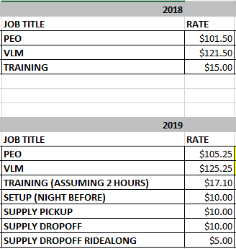
Your Paycheck

Slide 5
Multi-Precinct VLMs
Thornville Elementary School – Kathy Skillman
Glenford Elementary School – Michelle Kopis
Holy Trinity School – Nancy Flautt
Junction City Elementary School – Dave Harmon
New Lexington Middle School – Scott Berry
Crooksville Intermediate School – Tammy Hahn
If you have an issue, please talk to your VLM before calling us.

Slide 6
Rovers
Thornville Elementary School – Christopher Truex
Glenford Elementary School & Mt Perry – Steve Holekamp
Holy Trinity School – Ed Snider
Junction City Elementary School – Dave Harmon
New Lexington Middle School – Scott Berry
Crooksville Intermediate School – Joe McGaughey
Monday Creek – Dick Fankhauser or John Yinger
Shawnee & New Straitsville – Dick Fankhauser
Corning & Pleasant – Corlyn Altier
If you have an issue, please talk to your Rover before calling us.

Slide 7
Responsibilities of Rovers
Troubleshoot Technical problems
Resolve machine & PollPad issues
Bring additional supplies to the polling locations
If you have technical difficulty,
If you attempt to correct a minor problem yourself, both parties must be at the machine.
Remain calm.
Check with your Rover and VLM before you call John’s cell phone or the Board office
Document the problem on the notepaper provided.
Use the remaining machines until the machine is fixed.

Slide 8
Youth At The Booth
We do not have any student workers
planned for this election

Slide 9
Supply Pickup and Setup
Supply pick up is on Monday, March 16th
BETWEEN 11:00 A.M. AND 5:30 P.M. Only VLMs & PEOs can pick up & drop off supplies (not spouses, neighbors, friends, etc.)
Supply set up is on Monday, March 16th from 6pm-7pm at all locations. This is the time our office has communicated to each of the polling locations. Please do not vary from these times. If other arrangements need to be made, you must first contact our office. Please call our office when your location is set up. The polling location must be secure prior to you leaving the supplies and machines.
During Setup:
CHECK YOUR GREEN TOTE SUPPLIES – CALL BOE IF ANYTHING IS MISSING.
DO NOT break the seals on the gray Ballot Box at any time.
DO NOT break the seals on the red bag, PollPads or the voting machines until Election Day morning.
All supplies and machines should be dropped off at the polling location.
Everything should be locked up at the polling location the night prior to the Election.
No supplies or voting machines should be left in your vehicle or taken home with you.

Slide 10
Setting up Polling Location
All PEOs should contribute to setting up the polling location.
When arranging the Polling Location, it is important to keep in mind:
You should be able to observe voters but not see how they vote.
Voters, including people with disabilities can easily get into and out of the polling location and have easy access to voting machines.
Machines should be arranged so that voters can vote privately to ensure a secret ballot.
Multi-precinct locations MUST have a separate table for their PollPads and paper ballots.
Setup diagrams will be provided when you pick up supplies

Slide 11
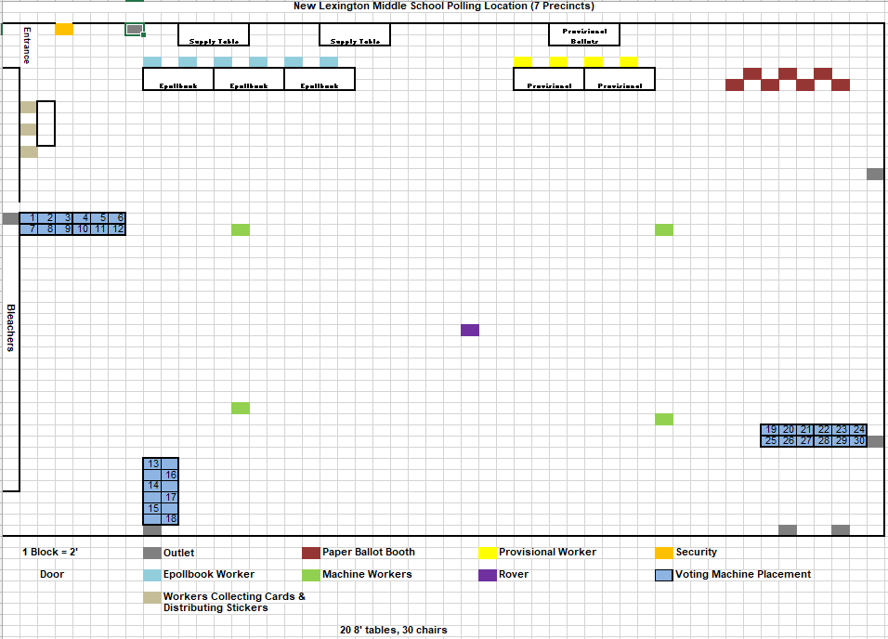

Slide 12
Paper Ballot Table
Paper Ballot Table (Multi-Precinct Polling Locations)
Thornville Elementary, Glenford Elementary, Holy Trinity School
Junction City Elementary, New Lexington Middle School, Crooksville Intermediate!
The paper ballots will be packed in the red bags for each precinct. The paper ballot table worker must get the ballots and bring them to the paper ballot table before the polls open. Be sure to account for the beginning number of ballots received – first thing on election day morning. This gets recorded on the blue reconciliation chart.
If a voter can not be found in the pollpad or if the voter has been flagged as provisional in the pollpad, they have to vote provisional OR if they wish to vote a paper ballot, you must send them to the paper ballot station.

Slide 13
Paper Ballot Table Continued….
The workers at the Paper Ballot station will have them sign
the Yellow or Green paper sign-in sheet.
The paper ballot table worker will collect the voted Provisional Ballots, check that all of the information is on the envelope and place it in the gray ballot box.
If the voter has requested a regular paper ballot, the voter should put the voted ballot into the ballot box once they have voted the ballot.
If the voter is voting curbside, two workers of opposite parties must process them.

Slide 14
Be sure to record the Provisional voters on the yellow provisional ballot sheet provided.
Paper Ballot Table Continued….
Be sure to record any voters who request a Paper Ballot, including 17 year olds and those voting Curbside, on the green Paper Ballot sheet provided.

Slide 15
Contacting the Board On Election Day
Contact numbers are located on the label on the front of your Flipbook.
Call 740-605-0803 and speak to John if:
Technical questions
Equipment malfunction
Call 740-342-2134 and speak to Jamie or Dee if:
Missing any supplies
Insufficient supply quantities throughout the day
Ballot shortages
PEO emergency or lack of workers
If we need to reach a PEO on Election Day
We will contact you via:
Your cell phone if you have one on file with our office
The Rover assigned to your location
The Polling Location contact

Slide 16
Supplies
After the polling location is set-up,
make yourself familiar with your materials.
Any forms that are filled out by voters should be put in the red bag.
Any notes that need to be made throughout the day should be made on the note paper provided and put in the Notes Envelope:
Detailed issues with the machines
Detailed notes about provisional voters
Detailed notes about voters who sign in but do not vote (for our reconciliation purposes)

Slide 17
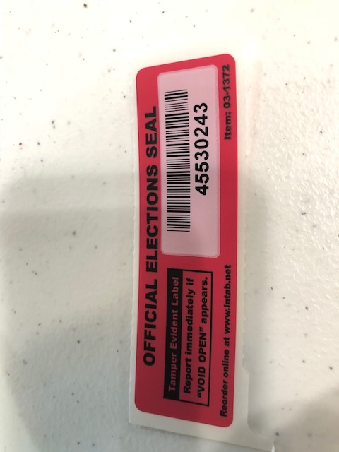
Tamper Tape
Security Tamper Tape – for paper rolls only!
This will be used if you use more than one roll of paper in the voting machine printer.
You will remove the full roll, put this tamper tape at the end of the roll,
and insert a new roll into the printer.
You must also put a tamper tape on the tape that stays in the machine at the end of the night.
The used/full rolls of paper should be placed in the red bag.

Slide 18
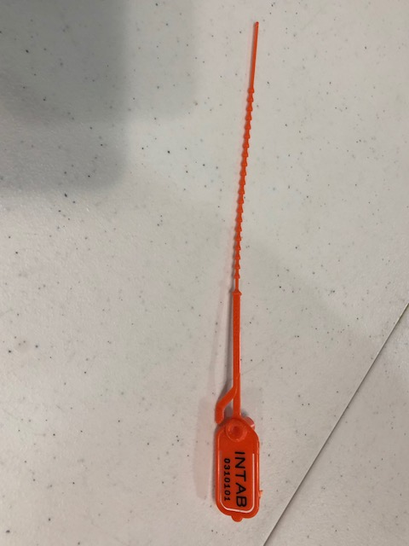
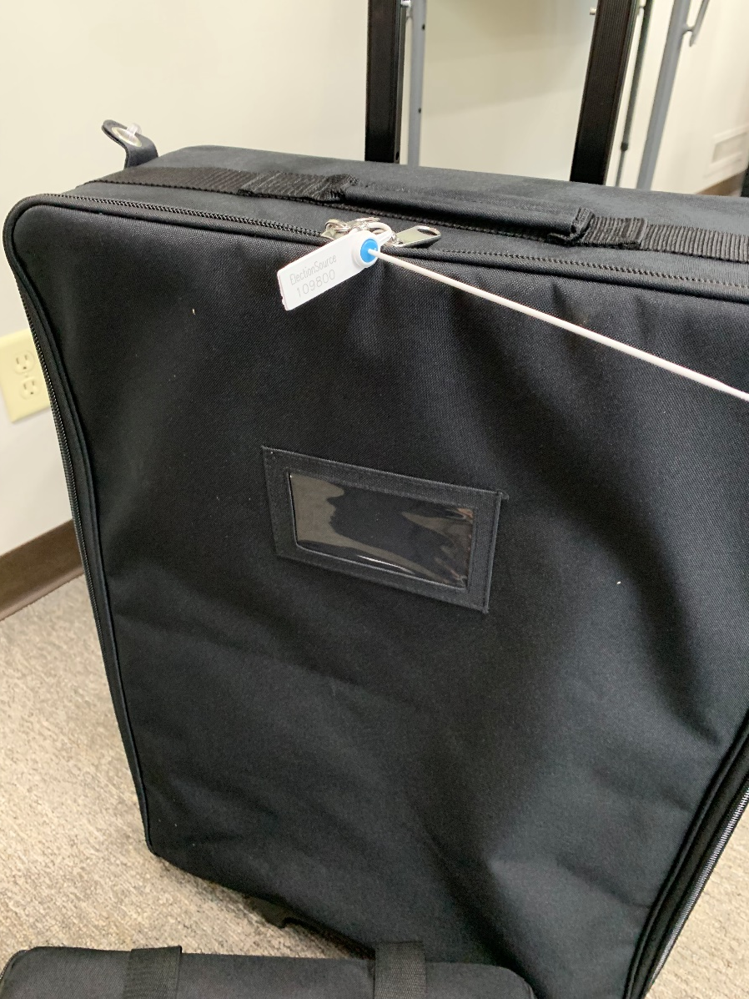
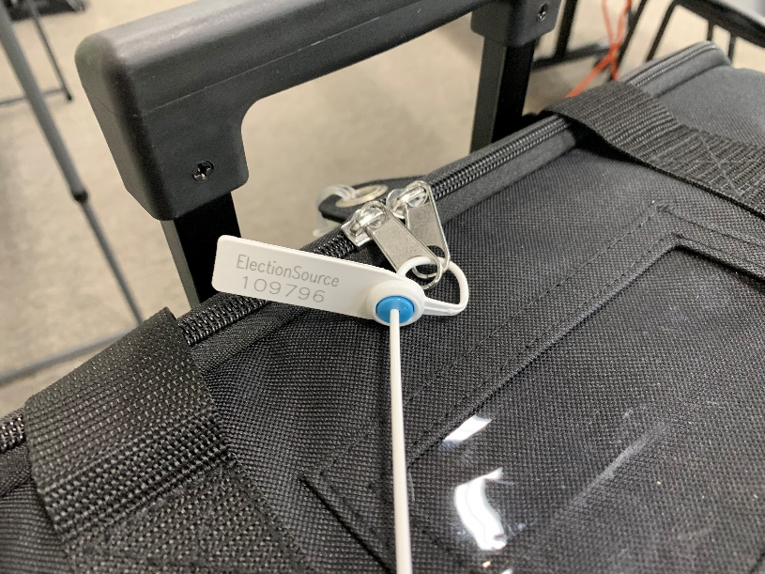
Security Seals
WHITE Security Seals – on the black voting machine bag and black printer bag
DO NOT REMOVE UNTIL ELECTION DAY MORNING
ORANGE Security Seals – on the Ballot Boxes NEVER TO BE REMOVED

Slide 19
Security Seals
There will also be seals on the doors on the back of your voting machine:
1 – Election Data – This holds the memory stick with the votes – Assigned staff only may remove this at the end of the night
2 – Power & Printer – Once you have attached all cords securely, attach the seal that is provided – it is taped inside your black machine bag – ONLY REMOVE AT THE END OF THE NIGHT TO PACK UP
3 – Accessories – these will all be locked with the exception of one machine per polling location. Once you attach your ATI device, attach the seal that is provided – it will be taped inside your black machine bag – ONLY REMOVE AT THE END OF THE NIGHT TO PACK UP
There is also a door for the battery. This door will not be sealed

Slide 20
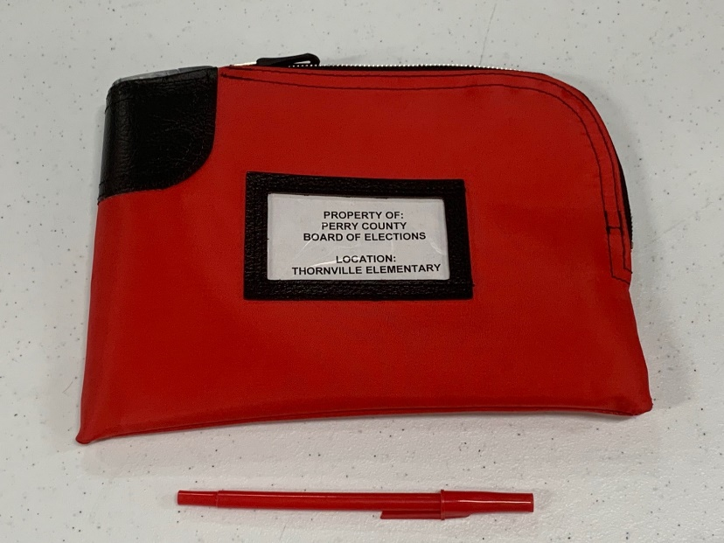
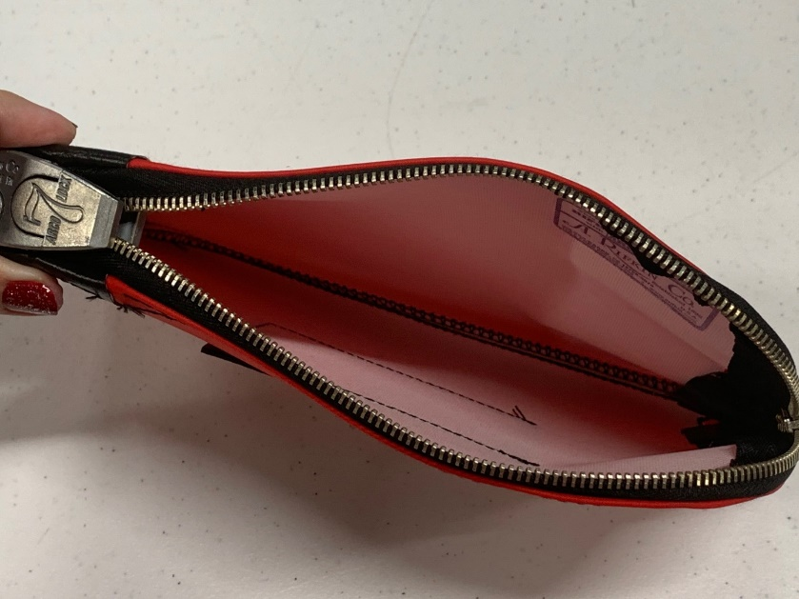
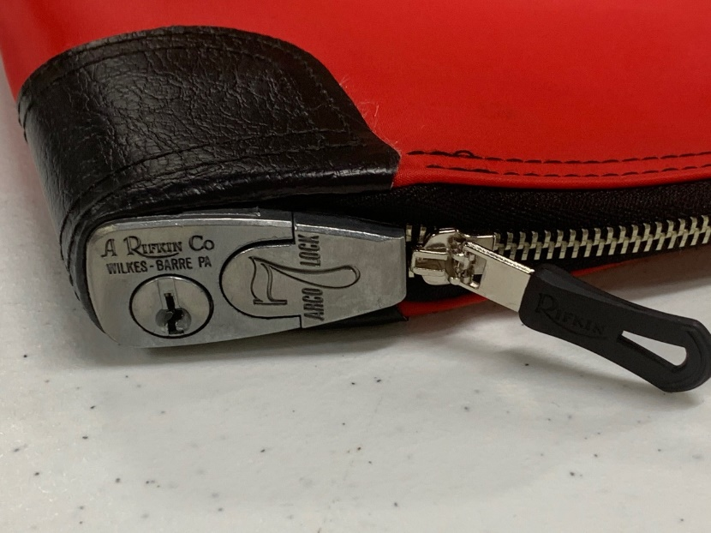
Flash Drive Bag
Assigned workers (of opposite parties) will remove the flash drives at the end of the night after the polls close.
You will need several people performing this process, especially at the multi-precincts.
Everyone needs to be working during tear-down.
We will pack this lockable flash drive bag in your green tote.
Mark each flash drive off on the check-off sheet inside this bag.
Two workers must count the flash drives to double-check the correct number of flash drives are inside.
Place the check-off sheet inside the bag.
Lock the bag.
Place the key inside the red supply bag (returned separately from the flash drive bag).
Hand the flash drive bag to Dee when you return to our office
(unless we inform you that we have workers picking up your bag).

Slide 21
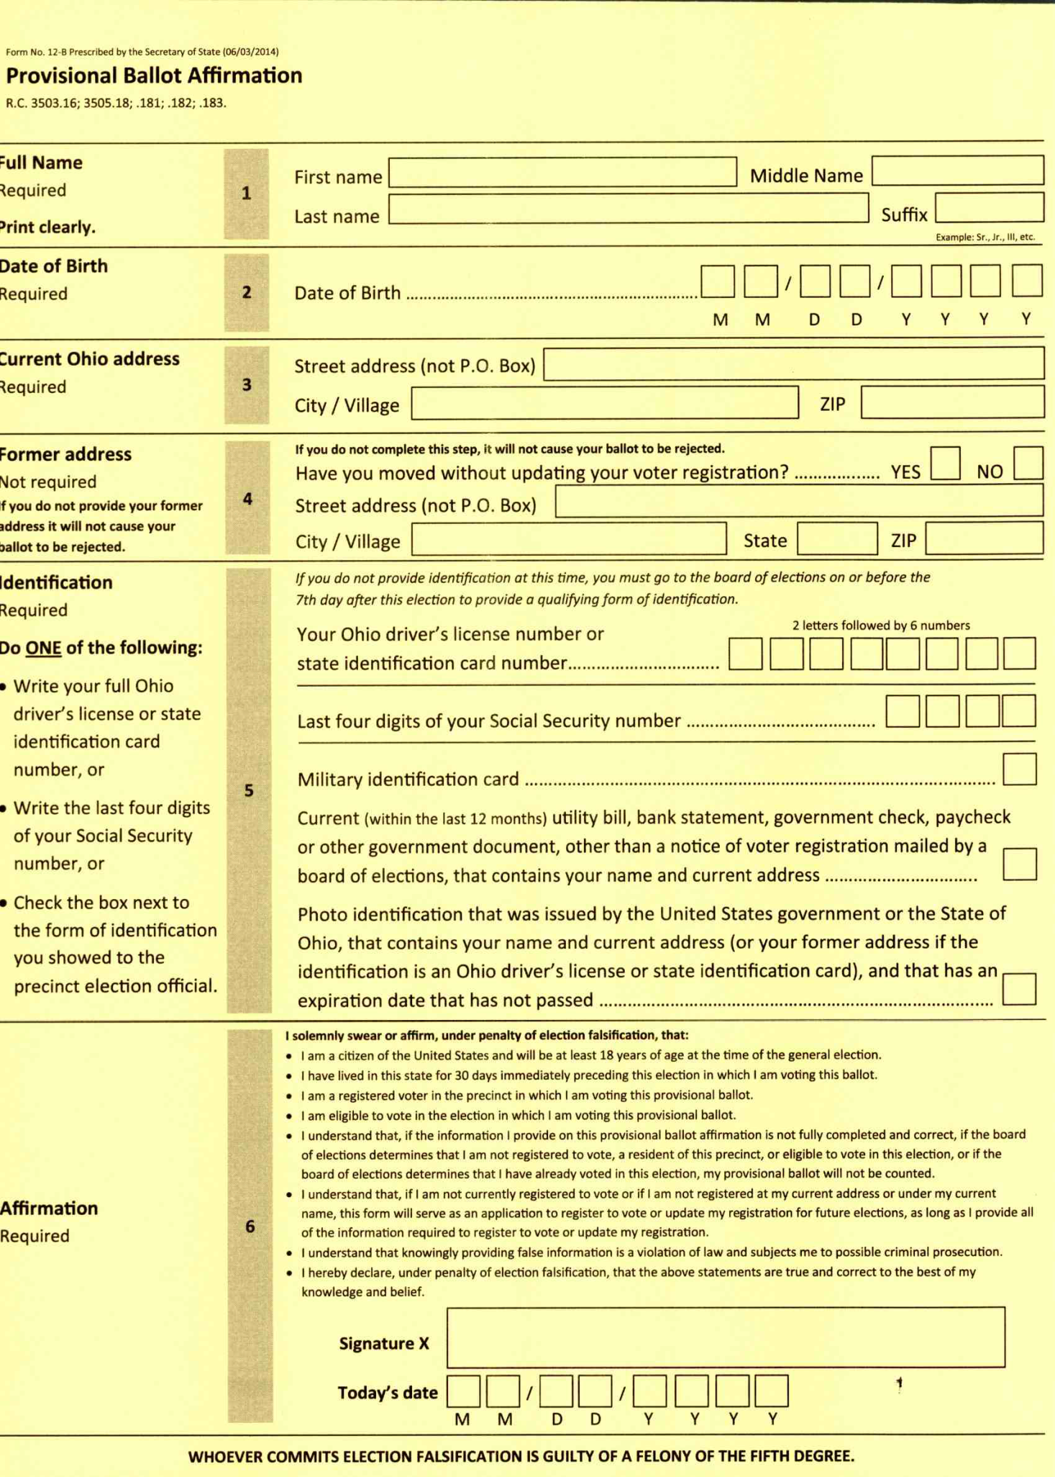
Front of Provisional Envelope
Additional Mailing Address
Or PO Box
________________________________________________
Precinct 0001_____
Ballot 012_____
VOTER MUST COMPLETE
1-6
PEO MUST WRITE THE PRECINCT NUMBER AND BALLOT NUMBER HERE
AND
PEO MUST MAKE CERTAIN THAT THE ENTIRE ENVELOPE IS COMPLETED BEFORE THE VOTER LEAVES THE POLLING LOCATION
PEO MUST ALSO CHECK FOR ID. IF NO ID IS SHOWN, PLEASE WRITE “NO ID” ON THE ENVELOPE.
This serves as their new voter registration and it is blank on the reverse side.

Slide 22
Provisional Ballots
If a voter meets ONE or MORE of the following criteria, the voter is to be provided a provisional ballot:
The voter’s name is not found on the pollpad;
The voter does not provide or is unable to provide proper or valid ID;
The voter has changed his or her name and did not provide proof of a legal name change;
The voter has changed his or her name and moved from one Ohio precinct to another without updating his or her voter registration by the registration deadline (30 days prior to the election);
The voter has moved from one Ohio precinct to another without updating his or her voter registration by the registration deadline (30 days prior to the election);
The voter was challenged before the election, a hearing was held, and the challenge was found by the board of elections to have merit;
The voter is marked (flagged) absentee or provisional on the pollpad, which indicates the voter may have already received a ballot before Election Day.
The voter is marked (flagged) on the pollpad because a Notice of Registration (Acknowledgment Notice Form 10-J) sent to the voter was returned as undeliverable. The voter must show valid proof of identity, and the voter MUST vote a provisional ballot; and/or
The voter is marked (flagged) that he or she was challenged before the election, and the hearing was postponed until after the day of the election.
NOTE: No absentee ballots can be accepted at the polling location on Election Day. The voter must return it to the county board of elections before 7:30 p.m. on Election Day.

Slide 23
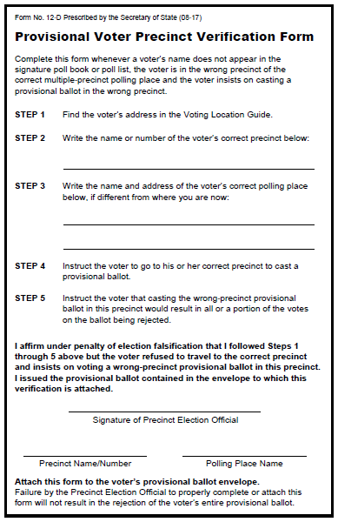
Form 12-D
IF THE VOTER IS AT THE WRONG LOCATION AND INSISTS ON CASTING A PROVISIONAL BALLOT IN THE WRONG LOCATION, THIS FORM IS REQUIRED TO BE ATTACHED TO THE PROVISIONAL ENVELOPE
(TAPE IT TO THE ENVELOPE)!
PEO MUST COMPLETE STEPS 1-5, SIGN, INCLUDE PRECINCT NAME / NUMBER & POLLING PLACE NAME

Slide 24
Provisional Reminders
Always double check the voter to make sure they have filled in their information thoroughly and correctly.
Always provide every provisional voter a copy of the Provisional Ballot Notice.
ONLY complete and ATTACH form 12-D for any voter that insists on voting in the wrong precinct.

Slide 25
Reconciliation Sheets
The Reconciliation Sheet is the
blue sheet and completed and signed by VLM and 1 other PEO (of the opposit party) after the polls close.
Please make sure this sheet is completed and make sure it reconciles. If it doesn’t reconcile, you are responsible for giving reasons why.

Slide 26
Our Mission Statement
As Representatives of the Perry County
Board of Elections, our mission is:
to make the voting experience as easy and uneventful as possible;
to gather and record accurately all voter information; and
to make sure all information and equipment is secure, safe, and returned to the Perry County Board of Elections.

Slide 27
Election Day Conduct
Unacceptable PEO Conduct:
1. You may not campaign at the polling location. This means no campaign clothing or materials of any kind. You may not attempt to influence voters on candidates or issues.
- You may not discuss politics amongst yourselves or try to politically persuade
those around you.
2. You may not have laptops, newspapers, iPods, or other music players, radios or televisions. Please take your cell phone for contact with the Board of Elections and in Emergency Situations ONLY.
3. You may not solicit contributions for raffle tickets or sell anything at the polling location.
4. You may not place any food or drink on the table where the books are located OR near the voting equipment or supplies.
5. You may not refuse to enforce election laws, especially the laws that apply to the precinct polling locations.

Slide 28
Election Day Conduct
6. Represent yourself well – you are also representing our office and the Secretary of State’s office.
Business casual dress
Shoes must be worn at all times – closed toe shoes
7. Be kind and courteous to others – we are all in this together!
8. If you are unable to work, please contact us as soon as possible.
9. PEOs may not leave the polling location at any time on Election Day (unless there is an emergency….but please call our office prior to leaving.)
10. If you are working, you may not bring your children to the polling location.
If you have complaints about another PEO’s behavior, please document the behavior and send it (in writing) to our office. If we receive complaints about behavior, the board will address it and will determine if you will be permitted to work at future elections.

Slide 29
VLM Responsibilities
Talk to the other PEOs before the election. Make arrangements for food, drinks, snacks etc. for Election Day
Oversee set up of the voting location
Double check and rearrange the setup if needed
Manage the polling location throughout the day
Cover the other judges during their lunch breaks
Assure that all voters are treated fairly and with respect
Be able to perform all PEO job duties
Do your best to make new workers feel comfortable and welcome
Be organized! When we are organized, voters have trust in our ability to run a fair election.

Slide 30
VLM Responsibilities (On Election Day – Before Polls Open)
Arrive no later than 5:30a.m.
If the location is not unlocked, please call the board office.
By 6:00 a.m., if you are missing PEOs, call our office immediately.
Open your supplies.
Administer the Oath of Office and have all 4 workers sign it.
Do not break any seals until the numbers have been recorded on the reconciliation chart.
Open PollPads, voting machines, and print & sign the zero tape
Materials in your precinct kits:
Tape the contents labeled “Post on Wall” to the wall in your precinct.
Precinct name sign to be hung on the front of your table.
Sample ballots (printed on green paper), will be in your supplies – can lay on your table for voters to use if they request it.
Flags must be placed 100 feet from the entrance of the polling location.
The 6:30am list will be sent out (1 per location) with your supplies

Slide 31
Posting List
6:30 list – provided at pickup
Post list at 11:00 a.m.
Post list at 4:00 p.m.
These lists are printed from the PollPad (print ONLY one list per polling location because they are all networked)
Please return all three copies with your supplies.
*THE POSTING LIST MUST BE MADE AVAILABLE TO ANYONE COMING INTO THE POLLS ON ELECTION DAY*
Post in an area where everyone will have access to it.

Slide 32
PollPad Workers
Set up pollpads on election morning
Check voter ID
Determine whether voters are regular or provisional
Tear down pollpad equipment at the end of the day and assist other precincts with tear down and return of equipment

Slide 33
Election Day
The following people are allowed in the polling location:
Voters, children of voters who are not yet of voting age, someone assisting a voter, persons checking the precinct voter lists.
Poll observers bearing a certificate of appointment, employees of the Board of Elections or Secretary of State (with ID), employees of the facility housing the polling location.
Credentialed members of the media may also be inside the polling location but may not interrupt the voting process. Please do not speak to the media; let our office know if the media comes to your polling location and we will send the media representative to speak to them on behalf of our Board.

Slide 34
Exit Polling
Pollsters conducting exit polling:
Not allowed inside the polling location.
They are permitted to be outside the polling location – even within the 100 feet of the entrance
May not wear anything that may be construed as campaigning for or against any candidate or issue on the ballot.
We are not aware of any exit polling for this Election.

Slide 35
Campaigning
Some people ARE NOT allowed inside the polling location:
Anyone campaigning or electioneering. These people may not be within 100 feet of the polling location. (Refer to your flip book)
Anyone wearing campaign garb must cover it before entering the polling location (if they refuse to cover it, they must still be allowed to vote).
Pollsters conducting exit polling may not be in the polling location but are allowed within 100 ft. of the polling place.

Slide 36
Who is Eligible to Vote on March 17th?
Anyone who is a registered voter in the State of Ohio.
Qualified voters must be U.S. citizens and reside in the precinct where they wish to vote by February 18th.
The deadline for registering in the State of Ohio for this Election is February 18th at 9:00pm.
Any registered 17 year old who will be 17 years old by March 17, 2020 AND 18 years old by November 3, 2020.

Slide 37
17 Year Olds
17 year olds must vote on paper. They may not vote on the voting machines.
17 year olds may only vote on nominations. They may not vote on “final” races, such as State Central Committee
Put their ballot in an orange 17 year old envelope and put it in the ballot box. Our board will verify that they did not vote on any “final” races.

Slide 38
Ballots
Parties are on separate ballots for this election.
The voter must choose
Democratic, Republican, or Libertarian
There are not any questions, issues, or levies on this ballot, therefore if the voter does not choose a party, there is nothing for them to vote on.
1 page ballot

Slide 39
There will be write-ins for this election: Presidential candidate
Write-In Candidates

Slide 40
Processing A Regular Voter
Verifying the Voter:
1.) Ask for their name, address & valid ID.
2.) Place their ID in the tray of the PollPad (or type in the first couple letters of last and first name).
3.) If the voter is registered with that name and address, they will be given an “authority to vote slip” and their voter card (for multi-precinct polling locations only; all others can keep the slips – all slips must be returned with your precinct supplies).
4.) Direct the voter to the voting machines
5.) PEOs collect the “authority to vote slips.”
6.) Authority to vote slips get returned in the Notes Envelope in the red bag.

Slide 41
Checking Identification
Ask the voter for his/her ID
Assure the ID is valid (not expired)
Compare the name and address on the voter’s identification with the name and address in the pollpad
Voter’s name and address MUST be current
Note:
An Ohio driver’s license or State ID card with an old address IS ACCEPTABLE as a valid form of ID necessary to cast a regular ballot when the voter’s current address is in the pollpad.
Voter changed his or her name and provides proof of the legal name change (e.g., a marriage license or a court order that includes the voter’s current and prior names), the voter may complete and sign a notice of change of name (Form 10-L) and cast a regular ballot, as long as the voter is registered to vote in that precinct).

Slide 42
PollPads
Process for looking up hyphenated names: all hyphenated names can now be looked up by either last name.
For example: If a voter’s name is Susan Jones-Miller, you can look up the voter under Jones or under Miller.

Slide 43
PollPads
Programming the Voter Card:
When you insert the card into the PollPad to program
it for the voter, it will be programmed for the following:
Correct precinct
Correct split (no splits for this election)

Slide 44
Voter ID Requirements
Please refer to the information in your flip chart to reference this information on Election Day.
Photo ID
Military ID
Utility Bill
Bank Statement
Government Check
Paycheck
Other Government Document
*Must not be expired and must include name and address*

Slide 45
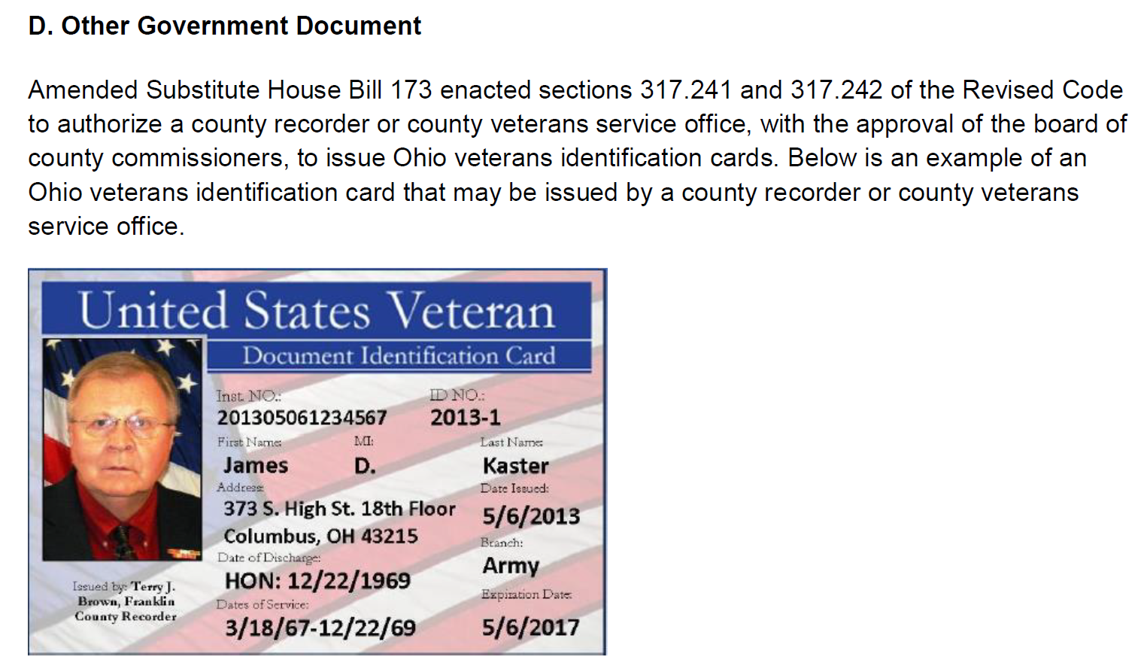
Veteran ID Cards

Slide 46
Ohio Law Prohibits the Following Forms of ID to be Accepted
Driver’s license or photo identification card issued by a state other than Ohio;
Social Security card;
Passport;
Birth certificate, unless voter still lives at the house where he or she resided at birth, and the birth certificate contains that home address, in which case this is acceptable as an other government document;
Insurance card; or
Any registration Acknowledgment Notice from the county board of elections.

Slide 47
What if the voter did not bring any ID?
If the voter is not able to provide a valid ID at the check-in table, the voter must vote a provisional ballot.
If the voter refuses to provide a valid ID at the check-in table, the voter must vote a provisional ballot.
No one is permitted to vote on the machines if they do not have a valid ID.
Note: An Ohio driver’s license or State ID card with an old address IS ACCEPTABLE as a valid form of ID necessary to cast a regular ballot when the voter’s current address is in the PollPad.

Slide 48
Voters without an ID
A voter who does not possess any form of ID acceptable for Regular or Provisional Voting may still cast a Provisional Ballot.
Follow the same provisional voting steps as provided
You must also give the voter a Provisional Ballot Hotline Notice form 12-H. This will inform the voter that they must come to the Board of Elections within 7 days and provide a valid form of ID. (This notice MUST be provided to every Provisional Voter.)

Slide 49
Voted Absentee
If a voter requested an absentee ballot for this election and if the voter states they did not use the ballot or did not return the ballot, they may only vote
a Provisional Ballot.
They may not vote on the machines.
You may not accept an absentee ballot at the precinct; it must be returned to the Board of Elections office, then they can go back to the polls to vote a Provisional Ballot if they wish to vote.

Slide 50
Assisting Voters
1.) All voters should first go to the PollPad table to check in. If a voter appears to be lost, please direct them to the table with the PollPads or to the VLM.
2.) Please keep conversation with the voters to what is necessary. Voters are there to cast their ballot.

Slide 51
Types of Paper Ballots
You will be provided with paper ballots in your red bag. Paper ballots are used for the following:
Provisional Voters – Ballot is placed in the Yellow Provisional Envelope then the PEO checks the envelope, puts the precinct and ballot at the top on the label provided, and places it into the BALLOT BOX.
Paper Ballot by Request – Ballot is given to the voter, then the voter should vote it, fold it and put it into the BALLOT BOX. NO ENVELOPE IS NEEDED.
Emergency Ballots – In the case of a power outage and the machines cannot be used, you must have the voters vote paper ballots. They should be voted, folded in half and placed in the BALLOT BOX. NO ENVELOPE IS NEEDED.

Slide 52
Paper Ballots
If a voter tears, soils, defaces, or marks a ballot in error, the voter may return it to a PEO, and a second ballot must be issued to the voter.
If the voter tears, soils, defaces, or marks a second ballot in error, the voter may return it to the PEO, and a third ballot must be issued to the voter.
In NO case may more than THREE BALLOTS be issued to a voter!
All voided ballots will be kept in the Voided Ballot Envelope in your precinct supplies.

Slide 53
Assisting Voters with Disabilities
Under both state and federal law, all Ohio polling locations must be ADA compliant and accessible to people with disabilities.
Voters with disabilities have equal access to all polling locations and the ability to cast a ballot PRIVATELY and INDEPENDENTLY.
One ADA accessible machine must be set up by the time the polls open.
Help America Vote Act (HAVA) requires that all voters must have the ability to independently cast a private ballot
The Americans with Disabilities Act (ADA) Set standards for ensuring that people with disabilities have equal access to public services and facilities.

Slide 54
General Guidelines For Assisting Voters with Disabilities
Be courteous and respectful.
Apply common sense.
Don’t patronize (treat adults like adults.)
Do not underestimate people with disabilities.
Disability does not equal inability.
Speak directly to the voter not their companion.
Offer assistance and listen for response-follow any specific directions. The person may not want help. Don’t insist.
Be patient (people with disabilities and seniors may need a bit more time to express themselves or to move about.)
Do not pet, feed or distract service animals. They are working animals not pets.

Slide 55
Mobility Impairments
Make chairs available for older voters or voters with disabilities, illnesses, or those who are pregnant.
Do NOT push or touch a person’s wheelchair without his/her permission.
Try to sit or kneel at the same level as the person in the wheelchair.
Ask if she/he wants assistance before trying to help.

Slide 56
Speech or Hearing Impairments
A voter who cannot speak may give his/her name and address to the poll worker by providing identification, who will then read the name & address out loud.
Follow the voter’s cues to determine whether speaking, gestures or writing is the most effective method of communication.
Rephrase rather than repeat sentences.

Slide 57
Blind or Visually Impaired
Identify yourself and state that you are a poll worker.
Visual impairment or blindness does not mean they cannot hear.
When giving directions to navigate in the voting location, be specific as possible and indicate obstacles in the path of travel.
All aisles and pathways to voting materials, registration and voting machines are 36 inches wide with no protruding articles.
All paths must be cane detectable.

Slide 58
Attorney-in-Fact
Prior to Election Day a voter may designate an attorney-in-fact, who is a person eligible to sign all election-related documents on behalf of the voter.
Such signing must be done in the voter’s presence.
The attorney-in-fact designation is specific to Ohio election law and not a general power of attorney.
This is to be used if the person cannot sign his/her own name.
Call our office if the voter says they have this form on file with the Board of Elections.

Slide 59
Curbside Voting
Curbside voting is the process followed when a person who is physically unable to enter a polling location can send another person into the polling location to inform PEO of his or her desire to vote.

Slide 60
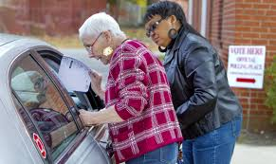
Curbside Procedures
Voter sends a representative into the polling location.
A bi-partisan team takes the green paper ballot sheet out to the voter
Voter signs his/her name on the green sheet
PEOs check ID
PEOs return to precinct to
Compare name in pollpad.
Prepare a paper ballot with curbside envelope and sticker
PEOs walk ballot out to voter
PEOs wait while voter votes the ballot (allowing privacy)
Voter places ballot into curbside voting envelope
PEOs hand the voter an “I Voted Today” sticker
PEOs deliver ballot and deposit into
the gray ballot box

Slide 61
Security & Emergency Preparedness
On Election Day, it is your responsibility to maintain security at the Polling Location.
In case of emergency:
Your highest priority is the safety of voters and election officials. Stop all voting and, if possible, gather the critical election supplies and keep them with you. Notify the BOE as soon as possible.
Fire: Exit the building and call 911. Carry out PollPads, all voter cards and ballots.
Power Outage: The voting machines will run on battery back-up for approximately 2 hours. Therefore, shut down all but one of your machines until the power is restored.
Disruption at polls: If at any time you feel threatened, call 911 and then call the BOE.
Medical Emergency: In the event of a medical emergency or other emergency requiring assistance from emergency personnel, call 911 and then call the BOE.

Slide 62
Security at Polling Locations
Schools will have a Sheriff’s deputy assigned to their polling location on Election Day.
Deputies are equipped with MARCS radio and cruisers
Deputies are there for the safety of the students and voters

Slide 63
Interacting with Transgender
and GNC People
If you are greeting a transgender/GNC person, you may recognize that their identification card does not match their presentation. If all other legal requirements are met, transgender/GNC people are entitled to their right to vote.
Do not assume a person is male or female.
Additional information can be found in your precinct supplies.

Slide 64
Processing Homeless Voters
If the voter is in the pollpad and they indicate that their address has changed, please follow these steps:
The voter needs to tell the PEO where they sleep at night.
Call Board staff with the above location.
Board staff will determine the precinct.
If the address has changed, they must vote a provisional ballot.

Slide 65
7:30 pm

Slide 66
Court Order
All polls in Ohio are to close at 7:30 p.m., unless a court order is issued. If a court order is issued, we will contact one VLM at each polling location to inform all PEOs at that Polling Location.
If a court order is issued, you must stay open and you shall not leave the polling location until the Board of Elections staff has released you.
Determine who the last person is in line at 7:30 p.m.
All voters in line by 7:30 p.m. get to vote a regular ballot.
All voters who arrive at the polling location to vote between 7:30 p.m. and the court ordered closing of the polling location vote a provisional ballot.
These provisional ballots must be kept separate from other provisional ballots voted during regular voting hours.
The PEO must mark on the outside of the yellow provisional envelope “After Close of Polls by Order of the Court.”

Slide 67
Preparing to Close the Polls
At 7:30 p.m., one PEO should loudly declare, “The polls are closed!” If people are waiting to vote at closing time, they must be allowed an opportunity to vote. To accommodate voters waiting in line:
Move the line inside the locked door of the polling location, if possible; or
Place a PEO after the last person who is in line at 7:30 p.m. to prevent additional people from joining in line.

Slide 68
Closing the Polls
Once the polls are closed, everyone must assist in final duties!
The VLM should assign each PEO a duty to help efficiently close the polling location.
These could include:
Neatly packing up materials
Cleaning up the polling location and restoring it as it was found (bring in flags, take down signs, etc.)
Closing the machines, print THREE copies of the results tape. Post one copy on the outside door of your polling place, place one copy in the red bag. Rubber band all machines from your location together, one copy that is attached stays in the voting machine (all three copies to be signed by four PEOs).
Seal the equipment
VLM completes the reconciliation sheet – one for each location
Record the seal numbers on the reconciliation sheet
Gather Posting Lists and return them with the red bag

Slide 69
Returning Your Precinct Supplies
After completing all duties at the Polling Location,
it is time to return the materials to the Board of Elections Office.
Two workers (1 Democrat & 1 Republican) must bring ALL election materials back to the Board of Elections PROMPTLY after finishing all duties at the polling location. (You must drive directly from the Polling Location to the Board Of Elections office AND YOU MUST RIDE IN THE SAME VEHICLE)
At NO time should the election materials be left with just one PEO. This is for your security as well as ours.
Upon arriving at the Board of Elections office, we will have workers to assist with carrying your materials and machines. Do not get out of your car. We need to get everyone through the line quickly.
You may not leave until your Chain of Custody form is completed and you have given us the Provisional Ballot Sheet. BOTH workers must initial the Chain of Custody Form.

Slide 70
Returning Your Precinct Supplies
Please be sure to help the other precincts at your location pack up.
It is not a race to be the first precinct back to the office.
For example: there are 7 precincts at New Lex Middle School. Please be kind and courteous and help the other precincts out – help tear down machines, carry and load supplies for those who may need help.
Student workers must check with an adult before they are excused.

Slide 71
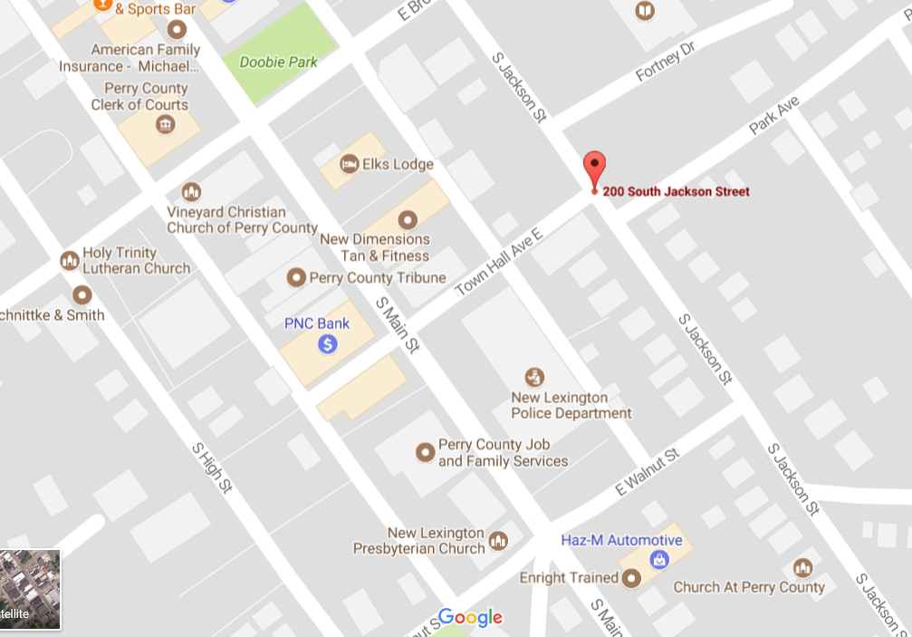
Returning Your Precinct Supplies
BOE

Slide 72
Tuesday, November 3, 2020
General Election
We need all of you to work if you are available.
Please let us know as soon as possible if you will not be available.

Slide 73
Contact Us Board of Elections Office (740) 342-2134
Visit Us Online
www.sites.google.com/perryelections
Like us on Facebook

Slide 74
Can someone vote on the machines without an ID?
Can 17 year olds vote on March 17th?
What do I do if I can’t find a form on Election Day?
What forms get handed to Dee on Election Night?
Do I hand-carry any ballots/forms/provisional ballots on election night?
Can someone request to vote on paper?
What are the yellow envelopes for?
Where do we put the yellow envelopes once they are completed?
How does someone change their political affiliation?
How does someone vote without an ID?

Slide 75
Questions

Slide 76
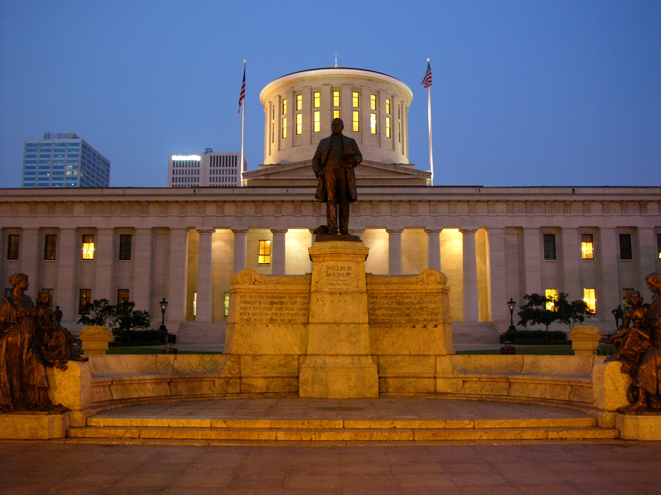
Thank You!
Your hard work is greatly appreciated!

